Slide 1
Intro to html
MCNDHS
Ms. Eng

Slide 2
aim: line breaks,horizontal rule
Do now:
go to this website:
http://www.vice.com/read/the-history-of-the-chola-456
Find four sentences that are affected by either:
<b></b>
<i></i>
<sup></sup>
<sub></sub>
Daily Grade:
On-time/attendance/not leaving the classroom: 25%
Cellphones: 25%
Notes:25%
Classwork/Homework: 25%

Slide 3

line breaks horizontal rule

Slide 4

line break/horizontal rule
Line break: <br> **NO CLOSING TAG**
Horizontal rule: <hr> **NO CLOSING TAG**

Slide 5


abbreviations and acronyms
<abbr title=“ INSERT YOUR DEFINITION HERE “> insert acronym</abbr>
Example:

Slide 6
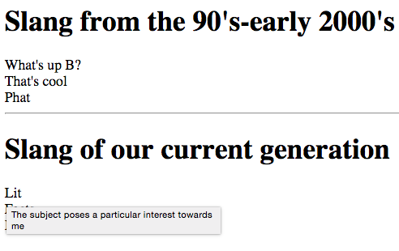
activity
Create two lists of slang from two generations with the abbreviations

